Slide 1
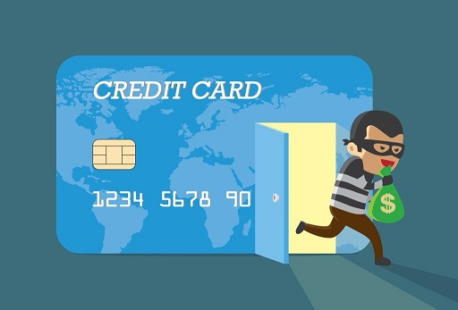
Credit Card Fraud Detection
Zaki Alawami
October 21, 2021
Kaplan/SDAIA Data Science Bootcamp

Slide 2
AGENDA
Problem Statement
Exploratory Data Analysis (EDA)
Performance Metrics
Model Selection & Training
Summary of Findings
Q&A

Slide 3
Problem Statement
Credit card providers, Banks, and Merchants can save billions of dollars that is lost annually to credit card fraud.
More importantly credit card holders (customers) will have a higher level of satisfaction, trust, and loyalty to their credit card providers if the latter can effectively detect and prevent fraudulent transactions, without annoying their customers with blocked legitimate payments.
How to prevent and manage credit card fraud?
Analyze a credit card transactions dataset
Discover insights
Create a classification model to predict fraud transactions.

Slide 4
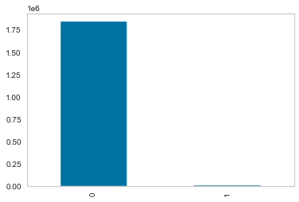
Dataset Description
Kaggle Dataset
Imbalanced Dataset:
21 columns/features
one target (valid/fraud)
~1.84 Million records
Fraud class is 0.52%
Features:
trans_date_trans_time | cc_num | merchant | category | amt | first | last | gender | street | city | state | zip | lat | long | city_pop | job | dob | trans_num | unix_time | merch_lat | merch_long | is_fraud
Notes:
1,842,743 Million records (9651 is the Fraud class records)

Slide 5
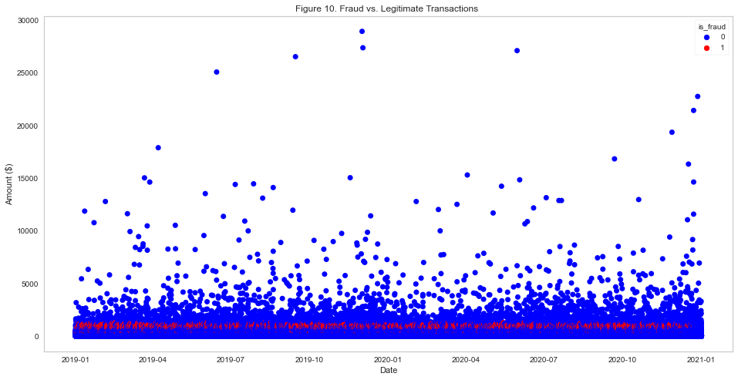
Exploratory Data Analysis

Slide 6
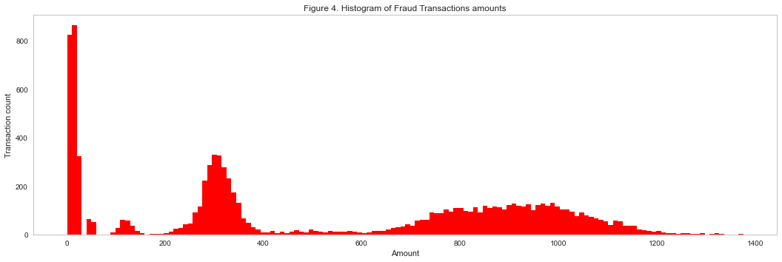
Exploratory Data Analysis

Slide 7
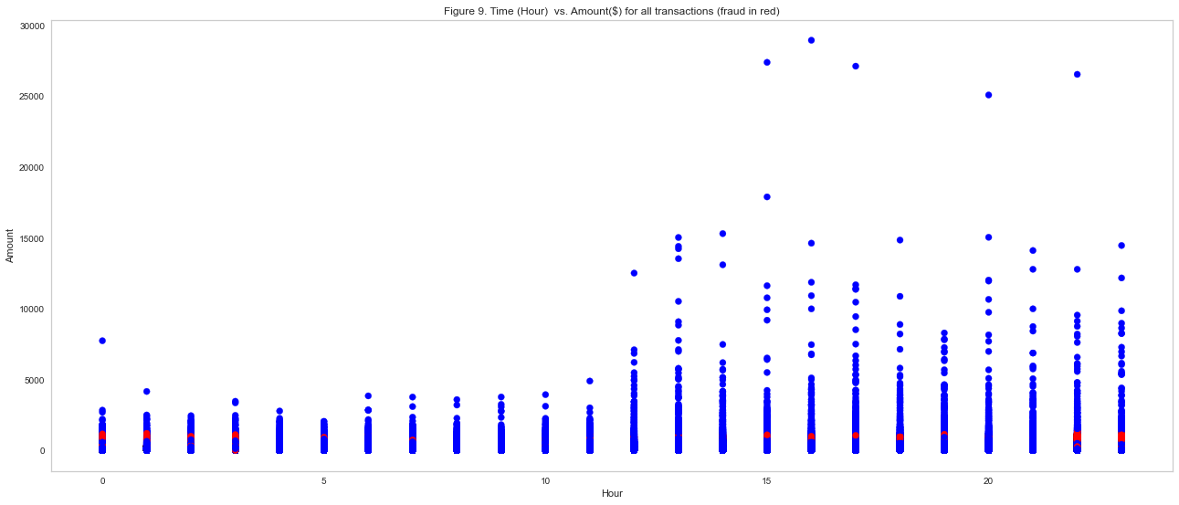
Exploratory Data Analysis

Slide 8
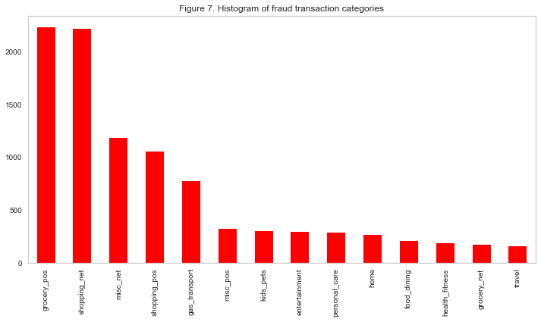
Exploratory Data Analysis

Slide 9
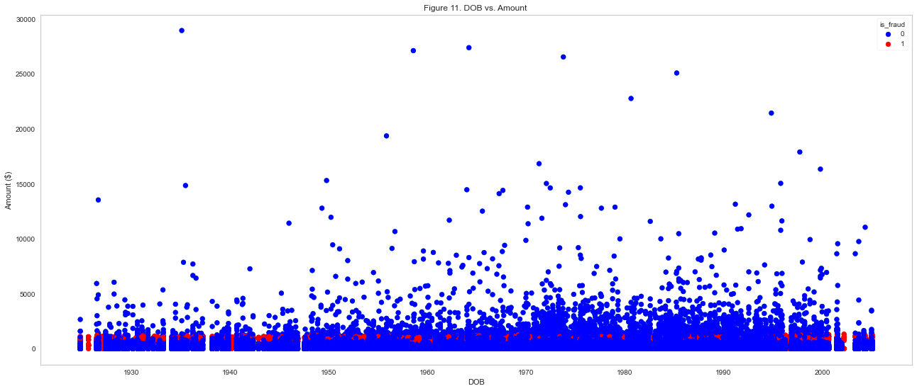
Exploratory Data Analysis

Slide 10
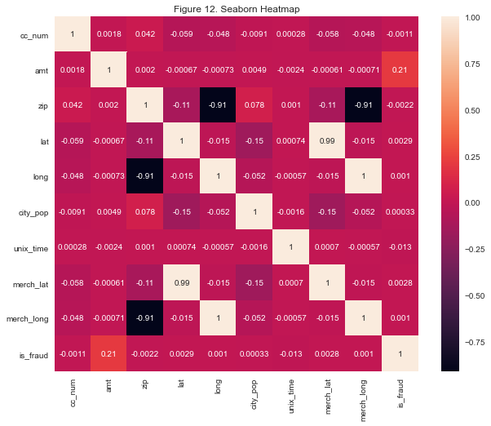
Exploratory Data Analysis

Slide 11
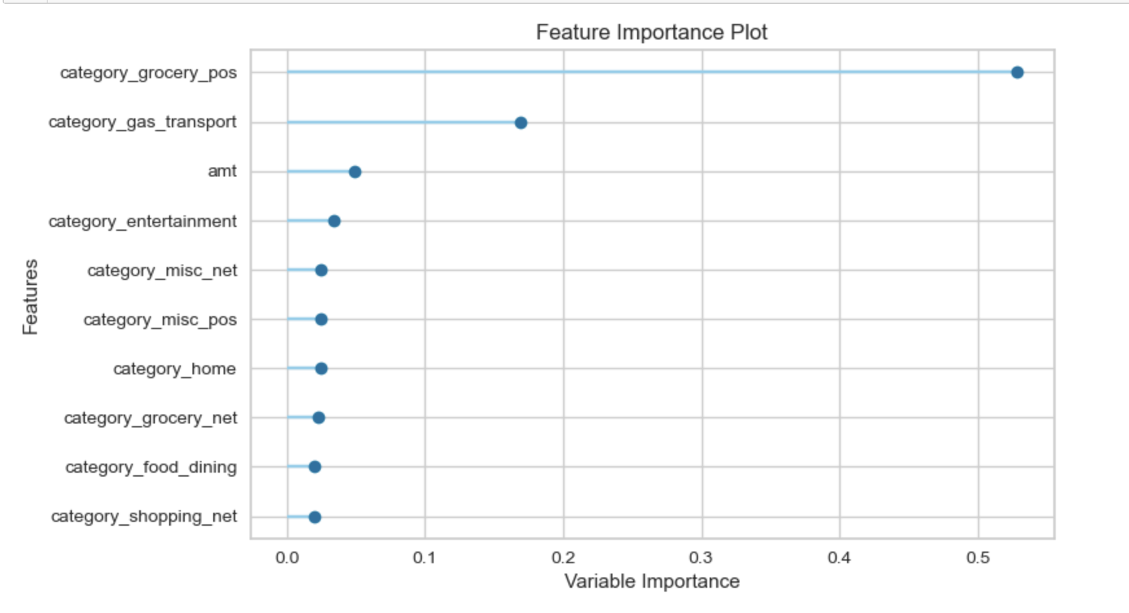
Feature Importance

Slide 12
Performance Metrics
Precision
The fraction of correct positive predictions
Recall
The fraction of positive cases predicted correctly.
F1 score
Balance of precision vs. recall
LTPFR
Legitimate Transactions Predicted as Fraud Rate:
(FP/ FP + FN)
High recall means you are confident you didn't miss any positive cases.

Slide 13

Models Selection & Performance
Model | Features | Accuracy | Precision | Recall | F1 | LTPFR
Linear Regression | All Numerical | 0.994828 | 0.000000 | 0.000000 | 0.000000 | 0.000000%
Random Forest | All Numerical | 0.996243 | 0.772349 | 0.387787 | 0.516331 | 0.059%
PyCaret/KNN | All Numerical | 0.9983 | 0.8052 | 0.9006 | 0.8502 | NA
KNN Problem | All Numerical | 0.998545 | 0.825840 | 0.910752 | 0.866220 | 0.100%
KNN | All Numerical (without cc_num) | 0.994780 | 0.477041 | 0.097599 | 0.162045 | 0.056%
PyCaret/Xgboost | All Numerical (without cc_num) | 0.9977 | 0.8395 | 0.6890 | 0.7567 | NA
Xgboost_v1 | All Numerical + ‘category feature one-hot encoded | 0.997833 | 0.849780 | 0.705637 | 0.771029 | 0.065%
Xgboost_v2 | All numerical + ‘hour’ new feature | 0.996980 | 0.836855 | 0.516701 | 0.638916 | 0.052%
Xgboost_v3 | All numerical + ‘category’ (ohe) + ‘hour’ feature | 0.998351 | 0.908068 | 0.757829 | 0.826174 | 0.040%
Xgboost_v4 | Only( ‘amt’, ‘category’, hour’) | 0.997941 | 0.857852 | 0.721294 | 0.783669 | 0.062%
Xgboost_v6 | Over sampling (1:2 ratio of pos/neg target) | 0.991543 | 0.374717 | 0.949896 | 0.537428 | 0.824%

Slide 14
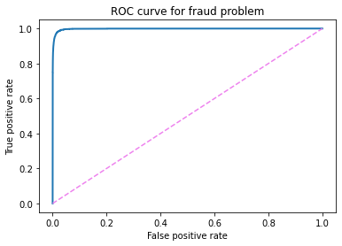
ROC Curve

Slide 15
Summary of Findings - EDA
From Figures (8, 9), we can see that fraud transaction occur mostly off-hours, between 3pm - 3am, but the majority of them occur between 10pm - 3am daily. This is when card owners are likely sleeping and therefore will not react quickly to the charges giving the criminals more time for making extra charges on the stolen cards.
From Figures (2,3,4), we can see that fraud transactions occur in specific amount bands, such as: $$1-20, $$200-400, and $$700-1200, and the majority of farud transactions are in the $$1-20. Figure 3 shows that the majority of charge amount is actually between $$0-2, which can be interpreted as criminals testing the stolen cards first with small amount to make sure the credit card is valid and active. This is an interesting behaviour that the model should be able to learn from to predict fraudulent transactions. Also the all fraud transaction amount did not exceed about 1500, which is about the check amount for pensioners, so as not to run over their monthly income (Very considerate criminals :) )
From Figure 11, we can see a very interesting behavior especially for senior citizens that there are only fraud transactions against their credit cards!! This could be a scam where scammers through phishing can get credit card companies to issue cards for senior citizens without their knowledge (mail credit card scams, or phishing for their personal data and using it to request a reissue of their credit cards). This may also mean that there are fraud credit card charges for some people that have already passed away! (birth year was around 1925).
Figure 5 shows that criminals do not discriminate against age of victims, they will hit anyone they can, but frequency of the age of the victims are mostly centered around middle age people, which makes sense as they are probably spending more and therefore using their credit cards more than the other age groups.
Figure 7 shows that the majority of the categories that criminals bought using the stolen credit cards are either "grocery_pos" and "shopping_net'. So criminals are using these stolen credit cards to buy their groceries in with Point of Sale machines/cashiers (in-person shopping). I found this behavior surprising as I thought it will be mostly internet shopping (e-commerce, but this is the next most common category.
From Figure (12,13) there does not seem to be a high correlation between features and the target.
Before converting 'trans_date_trans_time' to datetime object, plotting using this feature took a lot of time and memory resources!
I started plotting using Plotly which generates interactive charts. The charts generated using plotly once generated consumed heavy memory resources which eventually caused may laptop to freeze. I then switched to matplotlib/Seaborn.

Slide 16
Summary of Findings – Predictive Modeling
The Model accuracy is too high in the case of Linear Regression -> Too good to be true!
Linear Regression accuracy is high because the test dataset is imbalanced, so even if we guess that all transactions are legitimate (not fraud), then we will still get high accuracy (99.5%)
So I need other metrics of model performance, mainly we will use the Precision/Recall/F1 Score in this case due to the imbalanced dataset, and I also use my own metric LTPFR, which I have defined above.
With that, I find out the Linear Regression Precision/Recall/F1 are all zero, mostly because the True Positive that has been predicted by LR is zero, which means that LR was not able to guess any of the fraud cases...this is a very Bad model.
Next, we try Random Forests, and as we can see it has a relatively good Precision/Recall and F1 balance.
I next set PyCaret loose on my data, and PyCaret predicts that KNN was the best model with best Precision/Recall. Something is wrong here and I will call this the KNN problem!
to investigate the KNN problem, I use Scikit-learn to invetigate further
It turns out that KNN when using cc_num, it overfits on this numerical feature, and can then generates very high performance metrics but they are bogus and when removing the cc_num features, KNN as expected under performs.
I use PyCaret again without cc_num, and now xgboost becomes the best model.
I now focus on xgboost with feature engineering.
I one-hot code the 'catgory' feature as it has high feature importance
I create a new feature, 'hour' as it was seen from EDA that it can be a good feature
the best model is xgboost with most numerical features (except cc_num) plous 'category' plus 'hour'
I tried other things like using a minimal set of features, oversampling (2:1), and using class_weights but this did not improve the performance, on the contrary it was worse.
in the future, I can use additional feature engineering, such as creating new features that detect when fraudsters first charge minima amount to cc, so they make sure it is a valid one, and then later buy goods.
I can also a Neural Network to see if it can deliver better performance.

Slide 17

Q&A

Slide 18
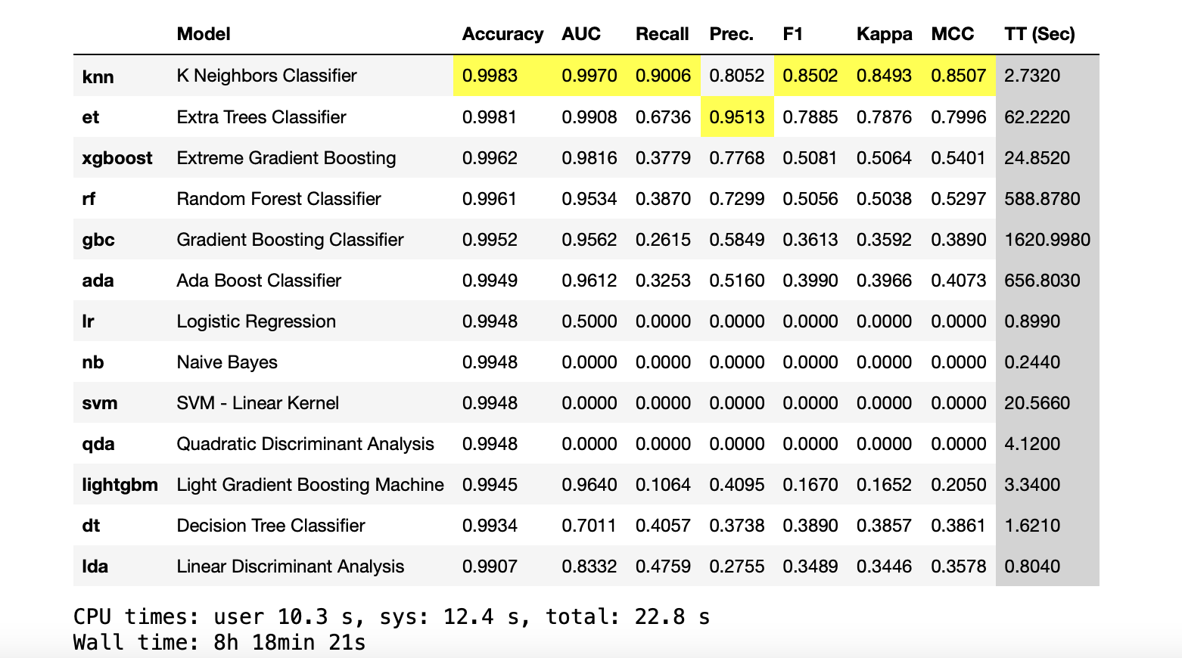
Pycaret Best Models

Slide 19
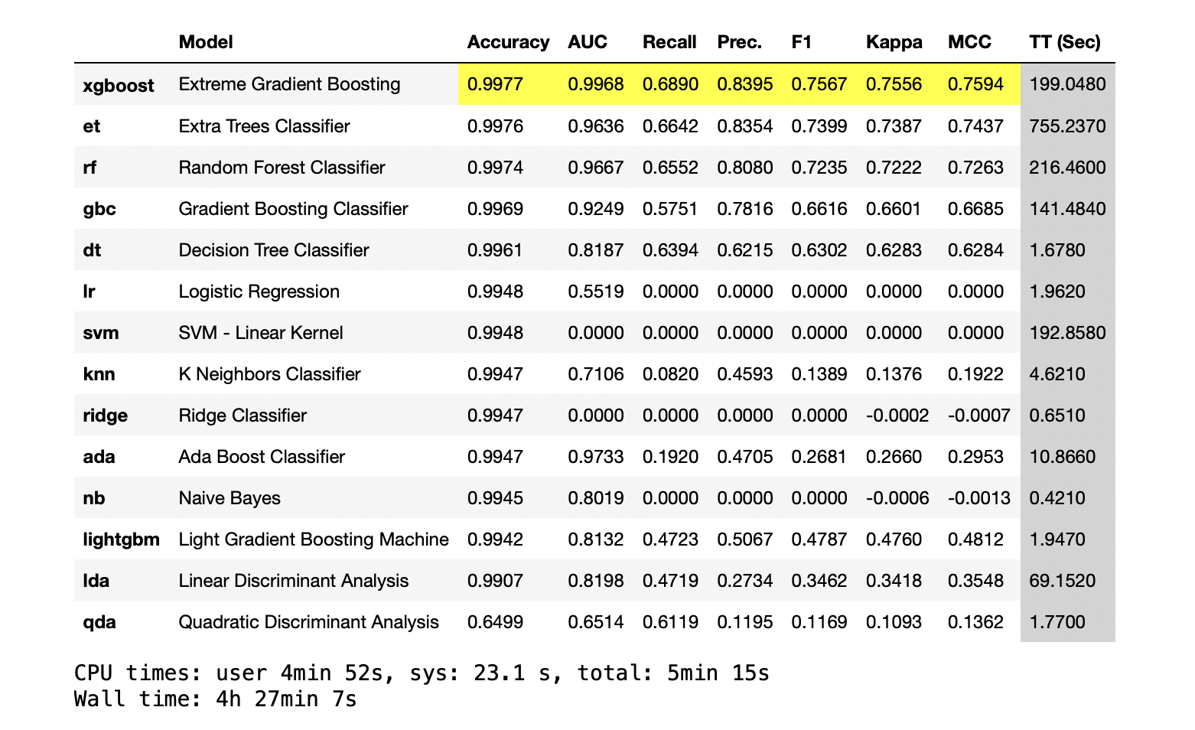
Pycaret Best Models

